Slide 1
Computer Arabization
Chapter 5: Speech Recognition & Text-to-Speech (TTS) in Arabic
Dr. Hend Shaaban

Slide 2
Introduction
Arabic Speech Recognition (ASR): The process of converting spoken Arabic language into written text using machine learning and signal processing.
Text-to-Speech (TTS): The process of converting written Arabic text into natural-sounding human-like speech using linguistic and acoustic models.
Why It Matters:
  Accessibility for the visually impaired
  Voice assistants (e.g., Siri, Alexa)
  Educational tools
  Automated transcription and call centers

Slide 3
Challenges of Arabic in Speech Technologies
Cursive Script: Characters change shape based on position.
Diacritics: Affect pronunciation and meaning; often omitted in text.
Dialects: Many regional varieties like Egyptian, Gulf, Levantine.
Phonetic Complexity: Arabic includes unique sounds such as ‘’ غ and ‘’ ع.
Right-to-Left Orientation: Affects processing and alignment.
Sparse Resources: Less open-source data compared to English.

Slide 4
Arabic Automatic Speech Recognition (ASR)
Workflow
Audio Input → Feature Extraction (MFCC) → Acoustic Model →
Language Model → Text Output
Tools
  Google Speech-to-Text API
  Mozilla DeepSpeech (custom Arabic models)
  Kaldi Toolkit
  CMU Sphinx (basic Arabic support)

Slide 5
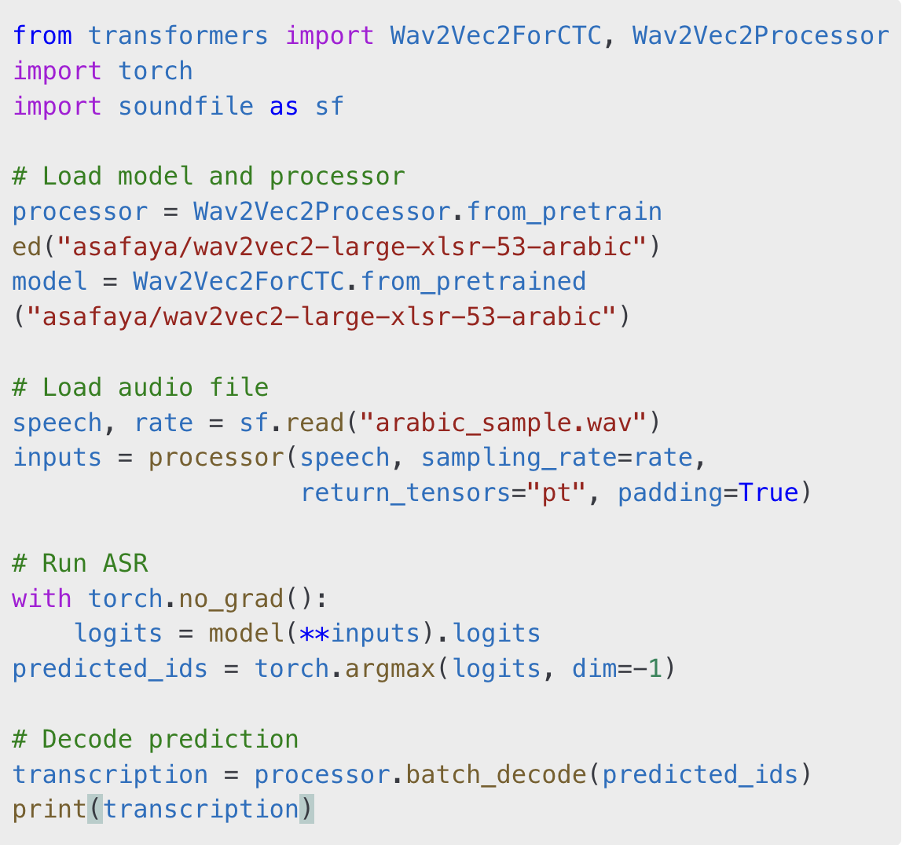
Arabic Automatic Speech Recognition (ASR)
Code Example: Using Wav2Vec2 with Hugging Face

Slide 6
Arabic Text-to-Speech (TTS)
Workflow
Text Input → Text Normalization → Phoneme Conversion → Prosody Modeling → Audio Output
Tools
  Google Cloud TTS
  IBM Watson TTS
  ResponsiveVoice, Acapela Group (commercial)
  Mozilla TTS with Arabic support

Slide 7
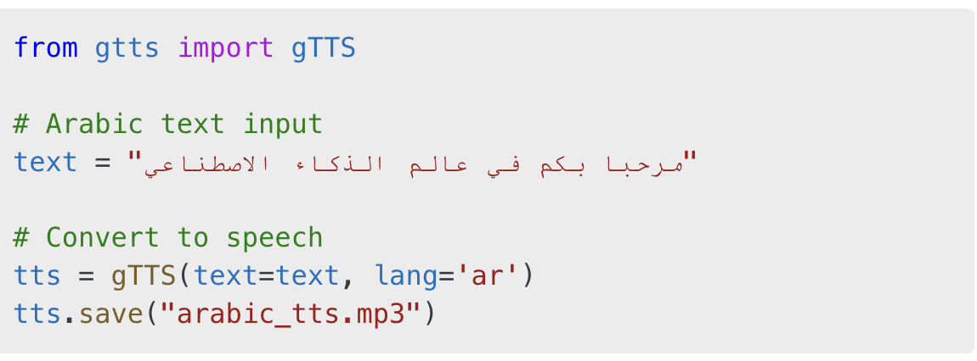
Arabic Text-to-Speech (TTS)
Code Example: Using Google Text-to-Speech (gTTS)

Slide 8
Datasets for Arabic Speech
Common Voice Arabic (Mozilla)
ArabicSpeech Corpus (OpenSLR)
MGB-3 Arabic Broadcast Challenge Dataset
KALDI Arabic Corpus

Slide 9
Use Cases
Education & e-learning
Smart home assistants
Customer service bots
Accessibility for visually impaired
Call transcription

Slide 10
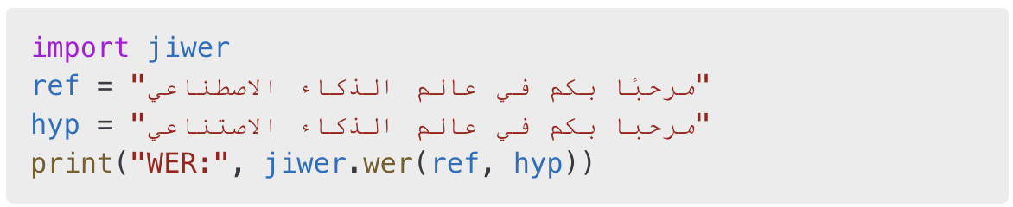
Evaluation Metrics
Word Error Rate (WER) = (Substitutions + Deletions + Insertions) / Total words
Character Error Rate (CER) = Similar calculation at character level
Code Example:

Slide 11
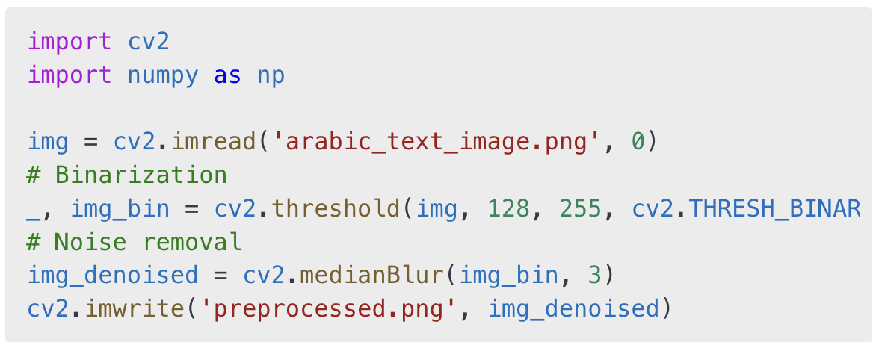
Enhancing Accuracy with Preprocessing
1. Preprocessing for ASR

Slide 12
Enhancing Accuracy with Preprocessing
Preprocessing for TTS
  Text normalization (remove diacritics)
  Split complex sentences
  Proper punctuation for better prosody

Slide 13
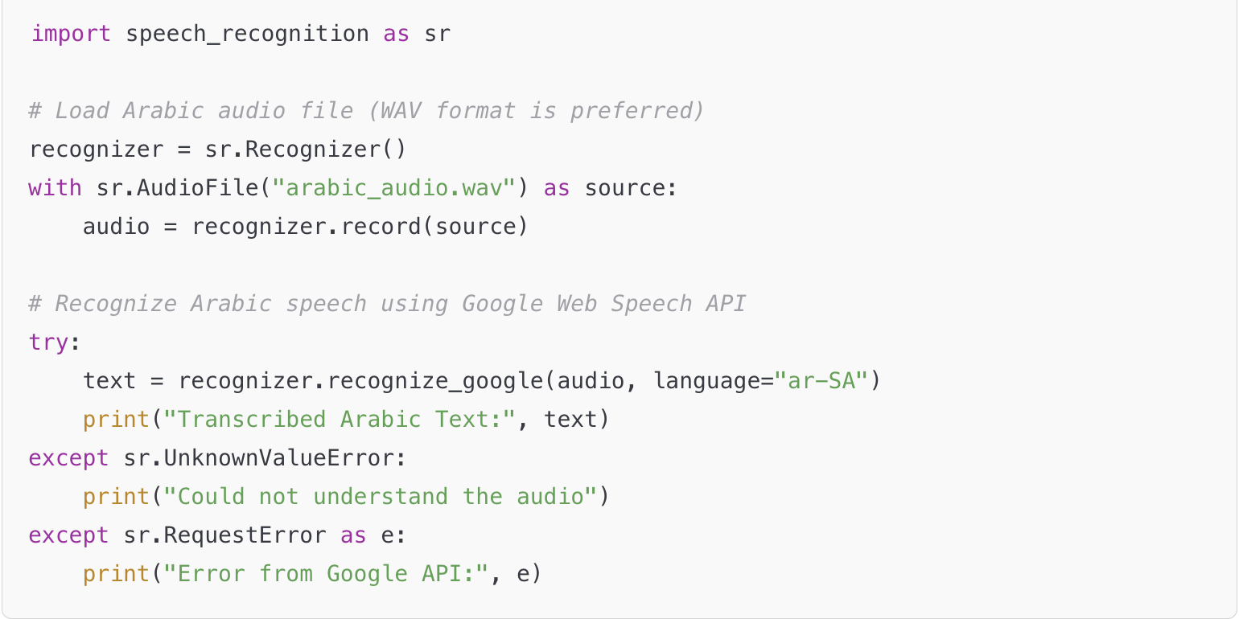
Arabic Speech Recognition Example (Using SpeechRecognition)
  You need a WAV file with clear Arabic speech for this example to work.

Slide 14
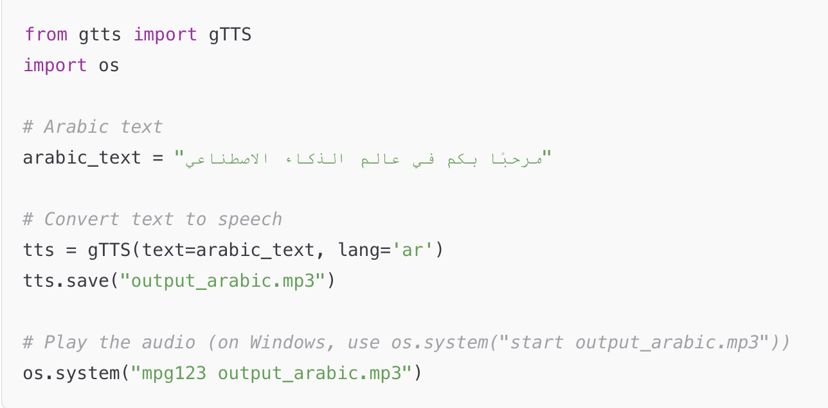
Arabic Text-to-Speech Example (Using gTTS)
  This will generate an MP3 file that reads the Arabic text aloud.

Slide 15
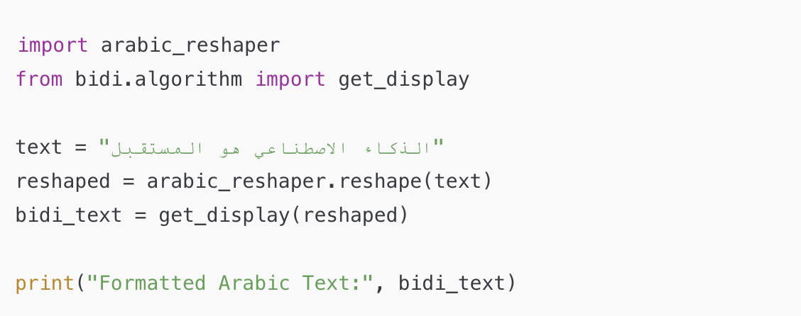
Arabic Text Display (Right-to-Left Support for GUIs or Plots)
  Arabic text needs reshaping and bidi support when displayed in visual interfaces like matplotlib, tkinter, etc.

Slide 16
Mini Project: Speak Arabic and Convert to Text + Back to Audio
You can combine the previous examples into a simple app that:
  Listens to Arabic speech
  Converts it to text
  Reads the text aloud using TTS

Slide 17
Mini Project: Speak Arabic and Convert to Text + Back to Audio
Arabic Speech-to-Text + Text-to-Speech App using Python. It will:
  Record or load Arabic speech and convert it to text.
  Display the transcribed text.
  Convert that Arabic text back into speech.

Slide 18
Mini Project: Speak Arabic and Convert to Text + Back to Audio
Prerequisites
Make sure you have these Python packages installed:
Also install ffmpeg or mpg123 if you’re using .mp3 playback:
  For Windows: ffmpeg.org
  For Mac: brew install ffmpeg
  For Linux: sudo apt install ffmpeg
Files Needed
An Arabic audio file (e.g., arabic_input.wav) with clear speech.

Slide 19
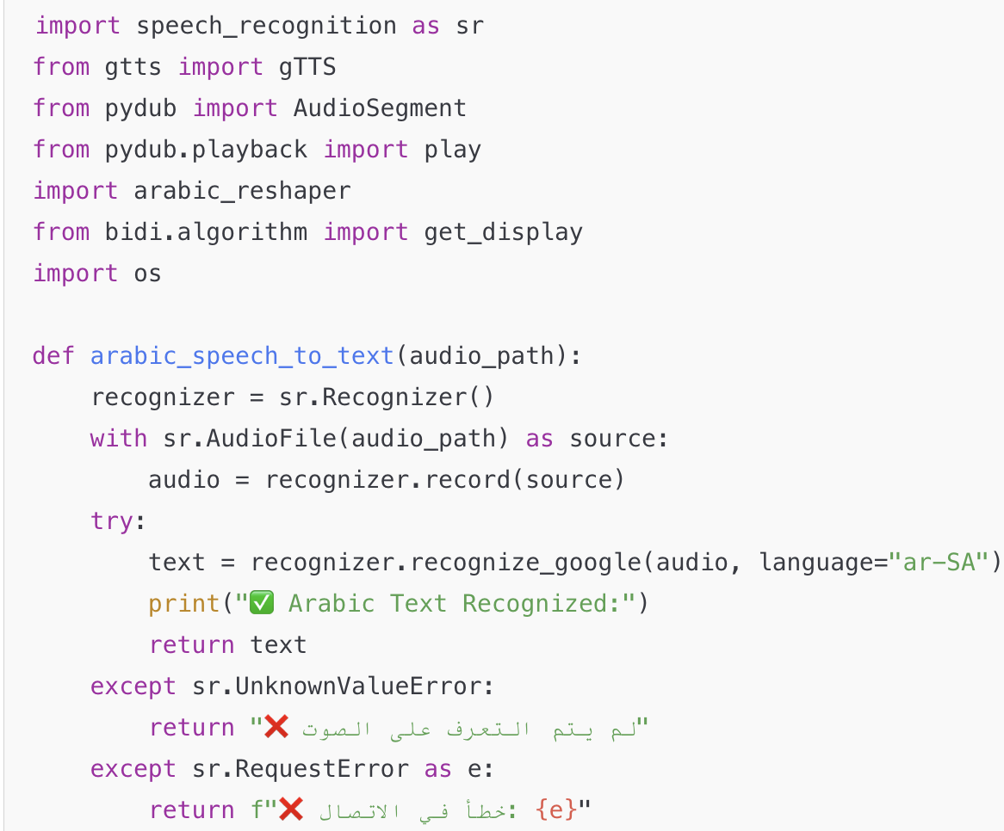
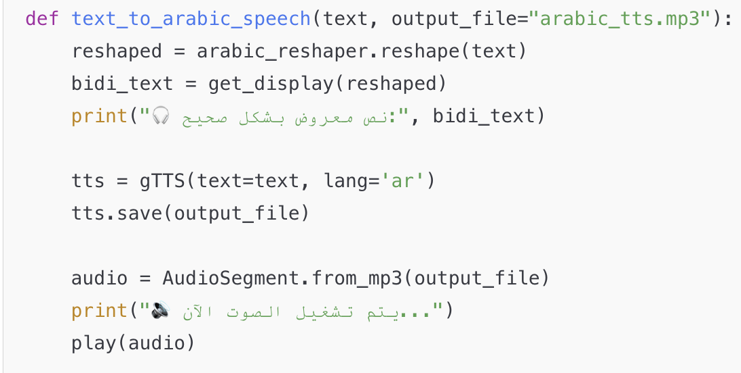
Speak Arabic and Convert to Text + Back to Audio: Full Python Code

Slide 20
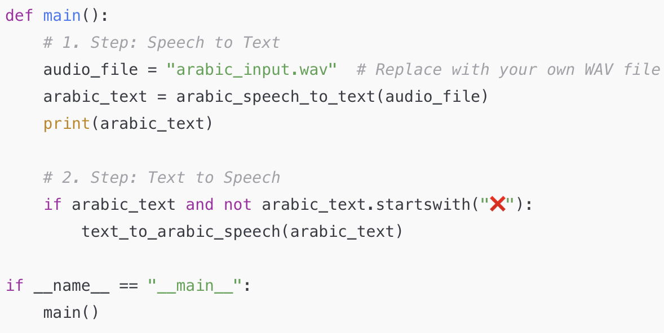
Speak Arabic and Convert to Text + Back to Audio: Full Python Code

Slide 21
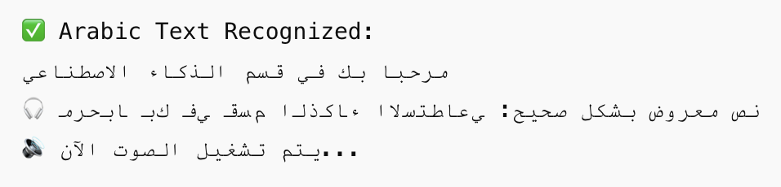
Speak Arabic and Convert to Text + Back to Audio: Output Example
If your arabic_input.wav file contains:
" مرحبا بك في قسم الذكاء الاصطناعي "
You'll see:

Slide 22
Bonus Ideas
Add a GUI with tkinter to record live audio.
Use PyAudio or sounddevice to capture mic input.
Add spell-checking or NLP post-processing (e.g., CAMeL Tools).

Slide 23
Future Directions
Arabic dialect-aware ASR models
Emotion-aware TTS systems
Real-time Arabic speech translators
Arabic speechbots in education & healthcare

Slide 24
Conclusion
Arabic ASR and TTS are evolving with AI and deep learning
High potential for accessibility, education, and smart applications
Still faces linguistic and technical challenges, especially in dialect handling

